Slide 1
HoneyMoon
harshiti
PPT for Event ID: 2
Date: 2025-01-10

Slide 2
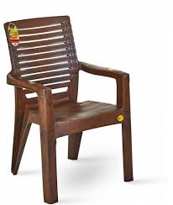
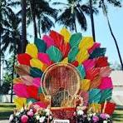
Category: Furniture
chair
chair
₹2000.00 x 20
₹500.00 x 1

Slide 3
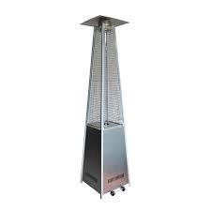
Category: Decor
Pyramid heater
₹3000.00 x 10

Slide 4
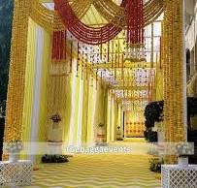
Category: Entrance
Haldi Entrance
₹30000.00 x 1

Slide 5

Category: Services
Russian Dancer
₹6000.00 x 10

Slide 6
Quotation Summary
Total Cost: ₹160500.00

